Slide 1
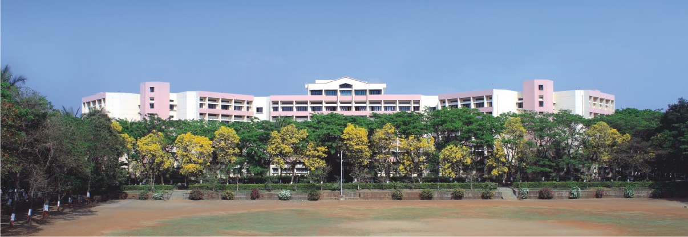

K. K. Wagh Institute of Engineering Education & Research Crime based clustering and zoning
Group Id : 24
Guide : Prof. Megha Patil
Notes:
NOTE:
To change the image on this slide, select the picture and delete it. Then click the Pictures icon in the placeholder to insert your own image.

Slide 2
Team members
Division./ Roll No. | Name of the student | Email ID | Contact Number
BE_B_17 | Aniket Desale | aniket.desale24@gmail.com | 9922940240
BE_B_18 | Vedant Patil | vedantpatil65@gmail.com | 9049916706
BE_B_19 | Yash Palekar | yash361113@gmail.com | 7758816113
BE_B_20 | Tanishka Patil | trp18102000@gmail.com | 8888866039

Slide 3

Contents
Problem Definition
Scope and Objectives
Block Diagram
Performance Parameters
Efficiency Issues
Tools and Techniques used
Cost Analysis
Results
Conclusion and Future Work

Slide 4
Problem Definition
To study reasons, factors and relations between occurrence of different crimes.
To identify criminal pattern to pace up the mechanism of crime solutions.
To learn and identify a person using his facial images

Slide 5
Scope & Objectives
To classify clustered crimes based on occurrence frequency during different years.
To find the difference between the facial characteristic of criminal and non-criminal faces.
To execute crime analysis from huge criminal data, an appropriate scientific field needs to choose.

Slide 6
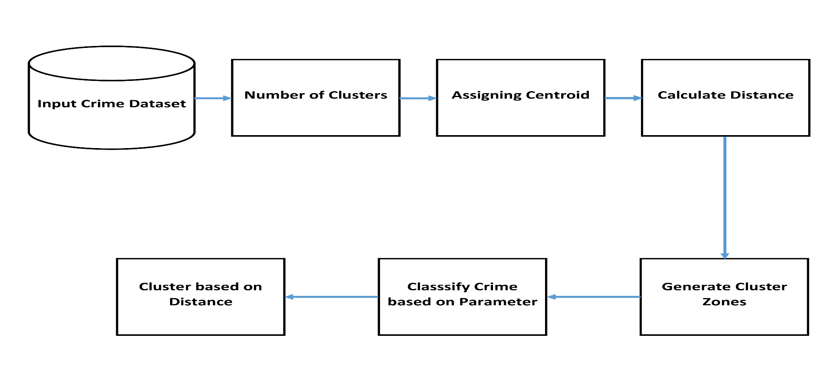
Block Diagram/Architectural Diagram
Fig. Block Diagram for Clustering

Slide 7
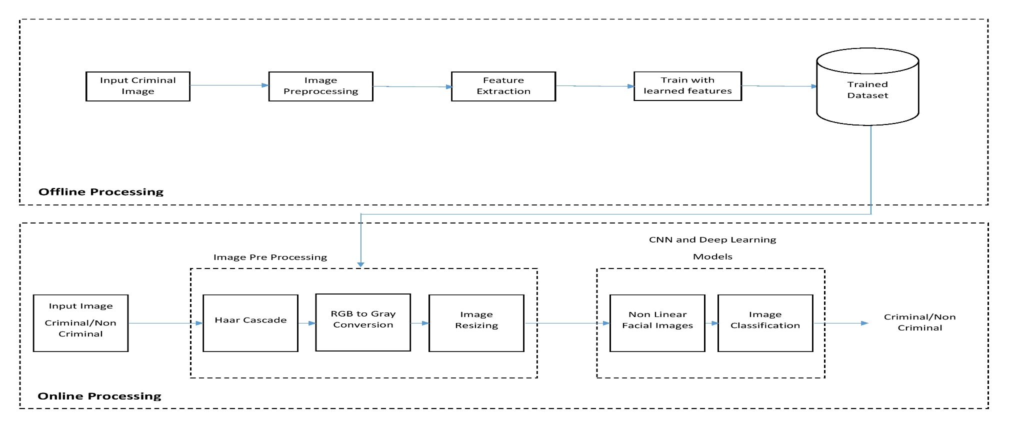
Fig. Training and Testing Model

Slide 8
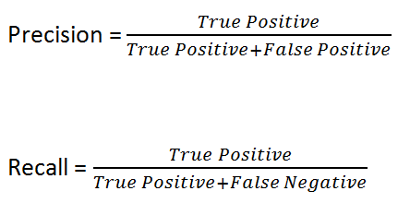
Performance Parameter
Experiments were conducted in an form of Precision ,Recall, Accuracy.
The precision of our project is 93%
The recall is 95%
The accuracy is 94%

Slide 9
Efficiency Issues
Time required to acquire dataset containing proper data regarding crime sections.
Proper dataset would determine and affect efficiency of the model.
Time taken to organize the cluster zones on based on crime category on the map graphically.

Slide 10
Tools
Operating System: Windows 7 or more
IDE: Visual Studio
Language: C sharp programming
Framework: .NET
Libraries: OpenCV, Emgu CV, AForge

Slide 11
Techniques
K-means Cluster Algorithm
Graphical Representation of Crime Data
HAAR Cascade algorithm
Segmentation algorithm
Sketch based Image matching

Slide 12
Cost Analysis
Duration of project
D=2.0 * (E) ^ 0.32
D=6.75 months
The approximate duration of project is 7 months.
Number of people required for the project
N=22.31/7
N=3.83
N=4 people
Therefore 4 people are required to successfully complete the project on schedule.
Cost of project
C=4*30*210=25200/-
Therefore, the cost of project is 25200/-(approx.)

Slide 13
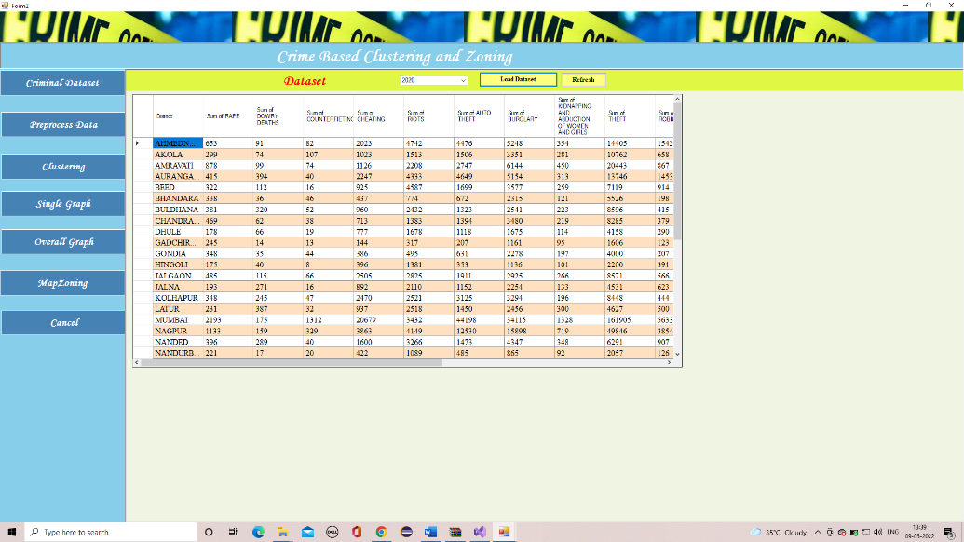
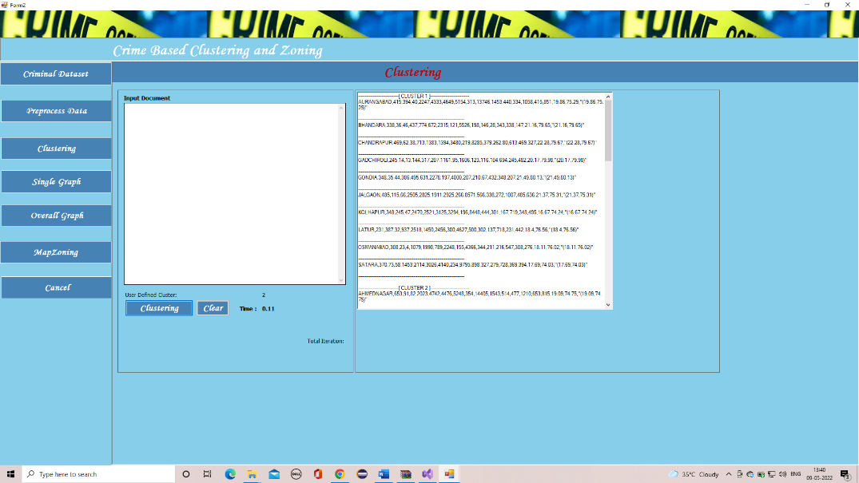
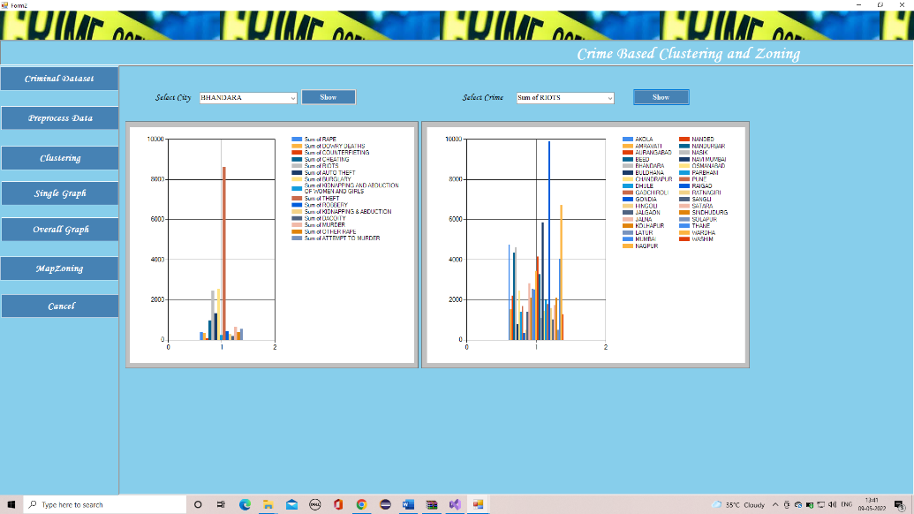
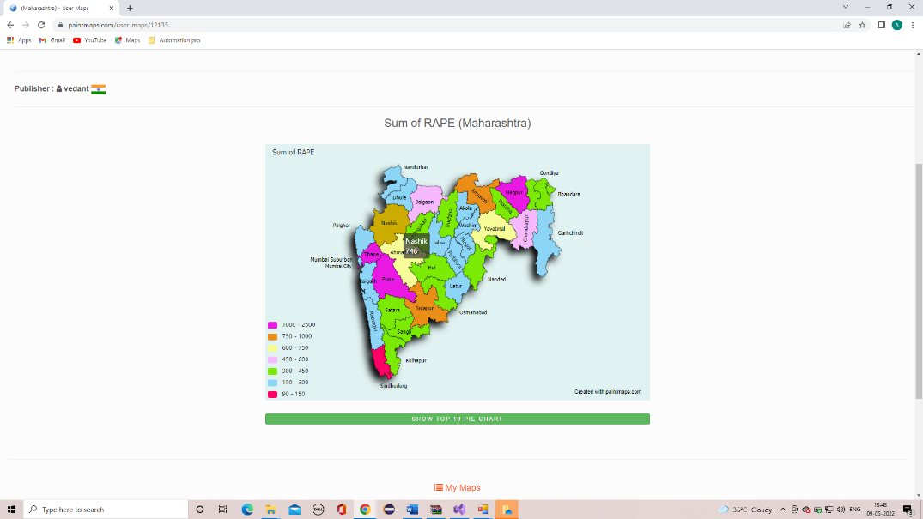
Results of Clustering

Slide 14
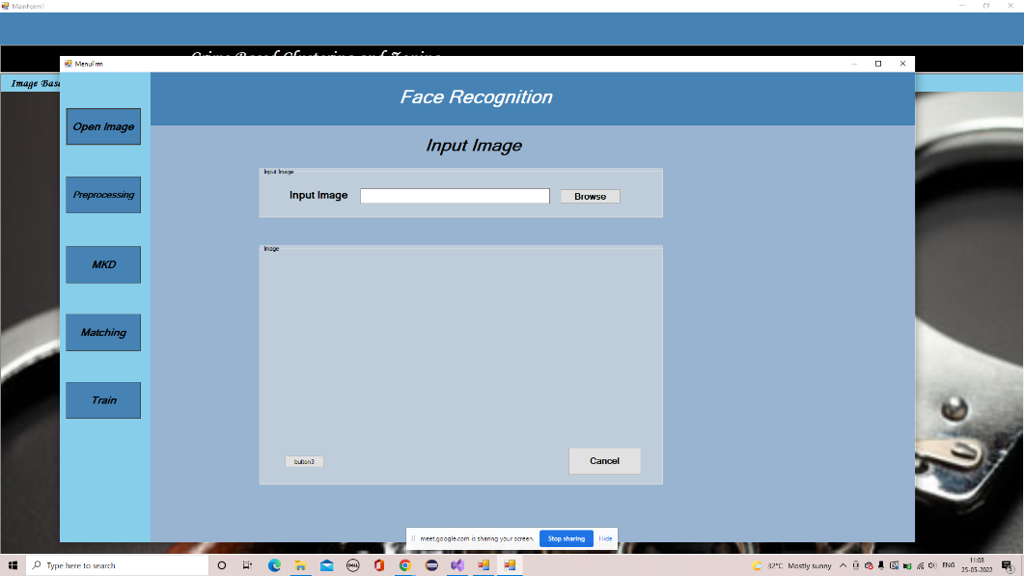
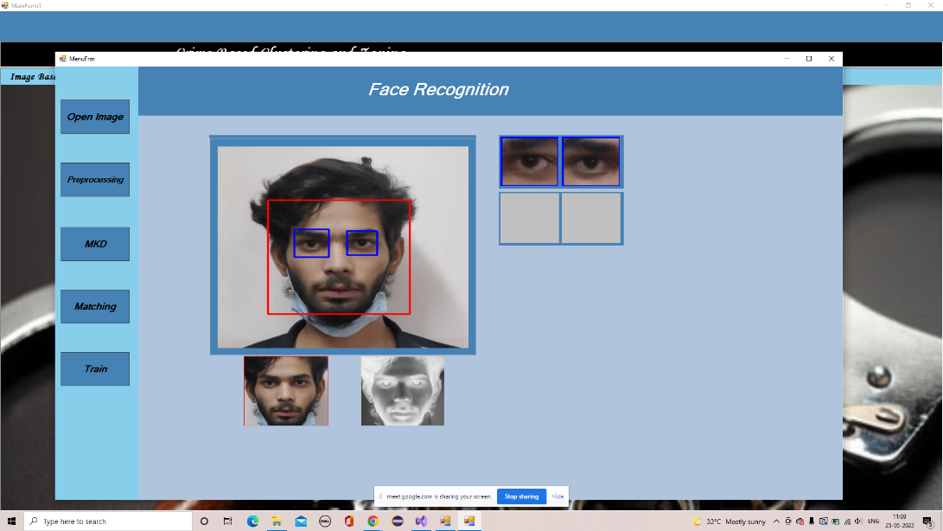
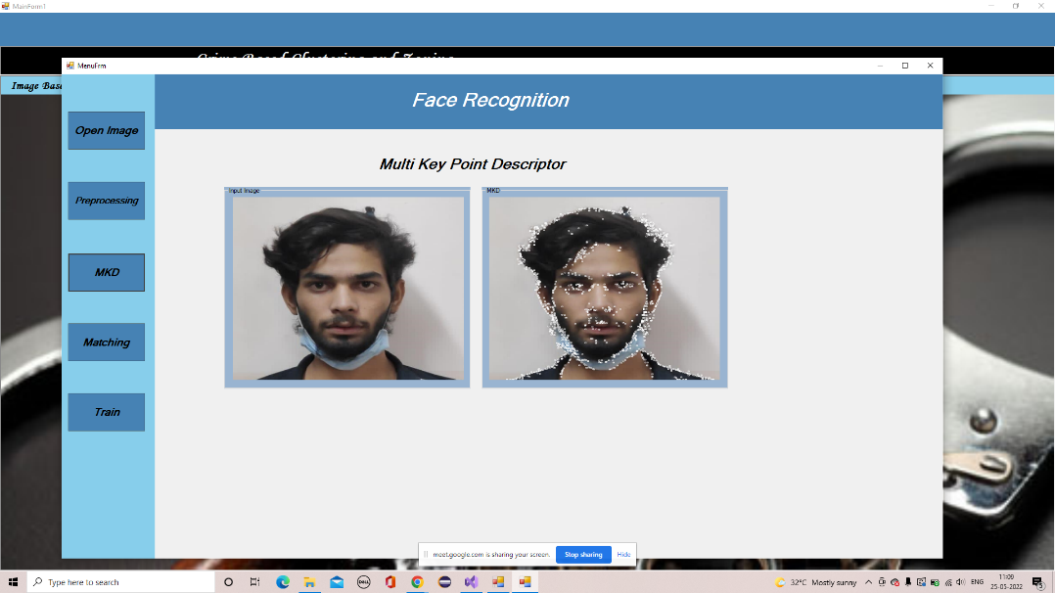
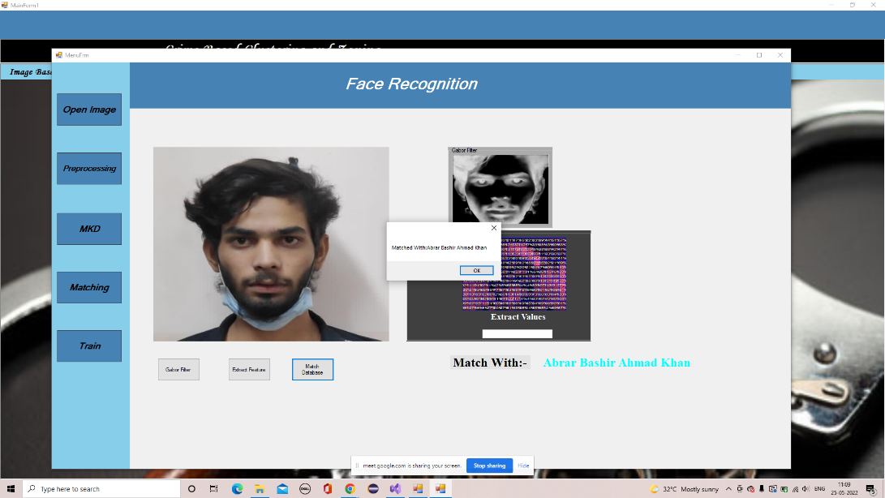
Results of Image Based Search

Slide 15
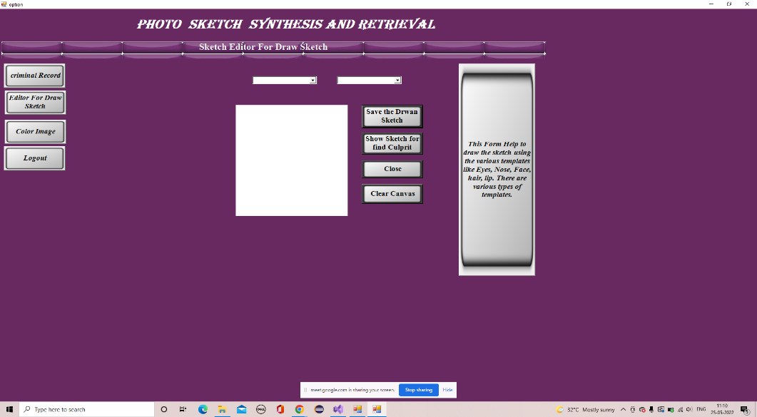
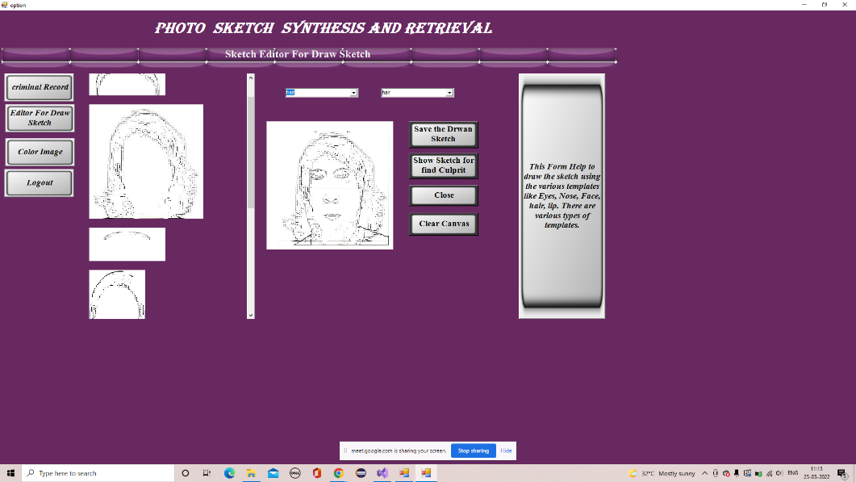
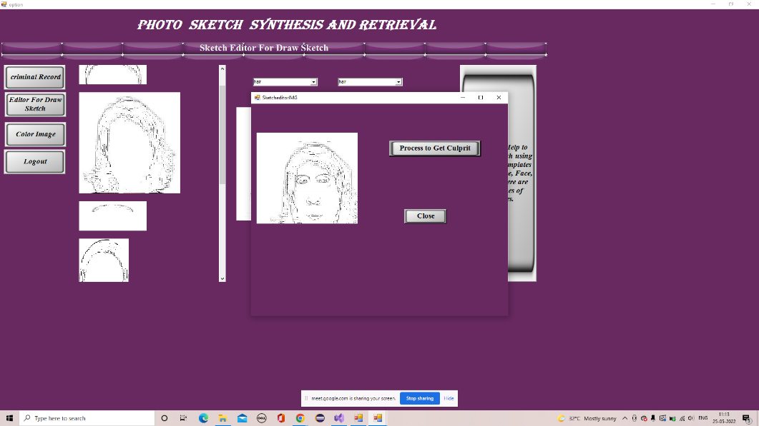

Results of Sketch Based Search

Slide 16
Conclusion
Crimes in India are rising at an alarming rate. So, to contribute toward combating crimes and to identify criminals, we proposed an integrated technology of CDCI (Crime Detection and Crime Identification) using DMT (Data Mining Techniques) for Indian Districts.
This system is designed specially for the general public to be up-to-date about their surrounding’s crime situations and take corresponding measures.
The system is able to identify and display crime clusters in a easy to understand and comprehending way for better implementation of law enforcement and will also help in detection of a specific individual at the crime scene.

Slide 17
Future Work
This system can be further developed into a mobile application for more ease of use. People can easily access data and also be aware of the areas.
People can upload images of suspicious people to get a check of criminal/non criminal person.
This system can also be used in law enforcement agencies like the police force.

Slide 18
Thank You !!

